Slide 1
Mass-Energy Equivalence

Slide 2
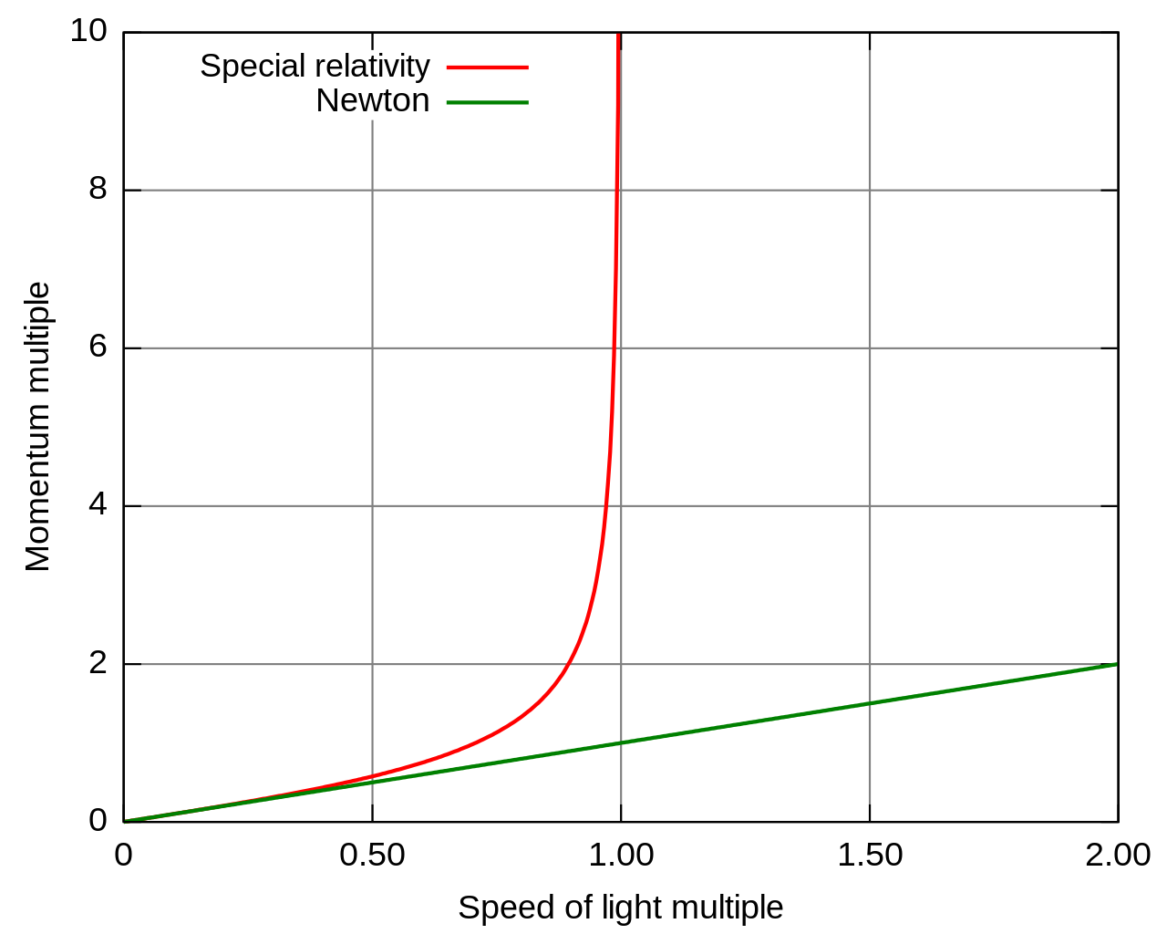
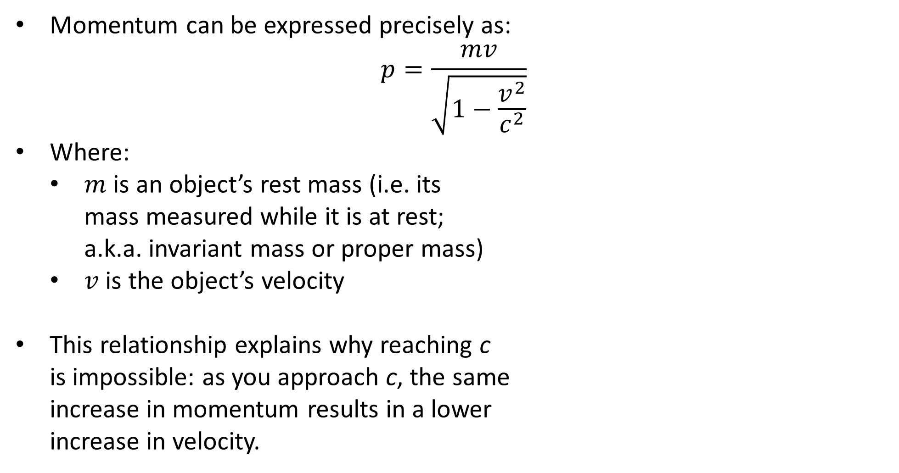
Relativistic Momentum Review
Momentum can be expressed precisely as:
$$p=\frac{mv}{\sqrt{1−\frac{v^{2}}{c^{2}}}}$$
Where:
$m$ is an object’s rest mass (i.e. its mass measured while it is at rest; a.k.a. invariant mass or proper mass)
$v$ is the object’s velocity
This relationship explains why reaching c is impossible: as you approach c, the same increase in momentum results in a lower increase in velocity.

Slide 3
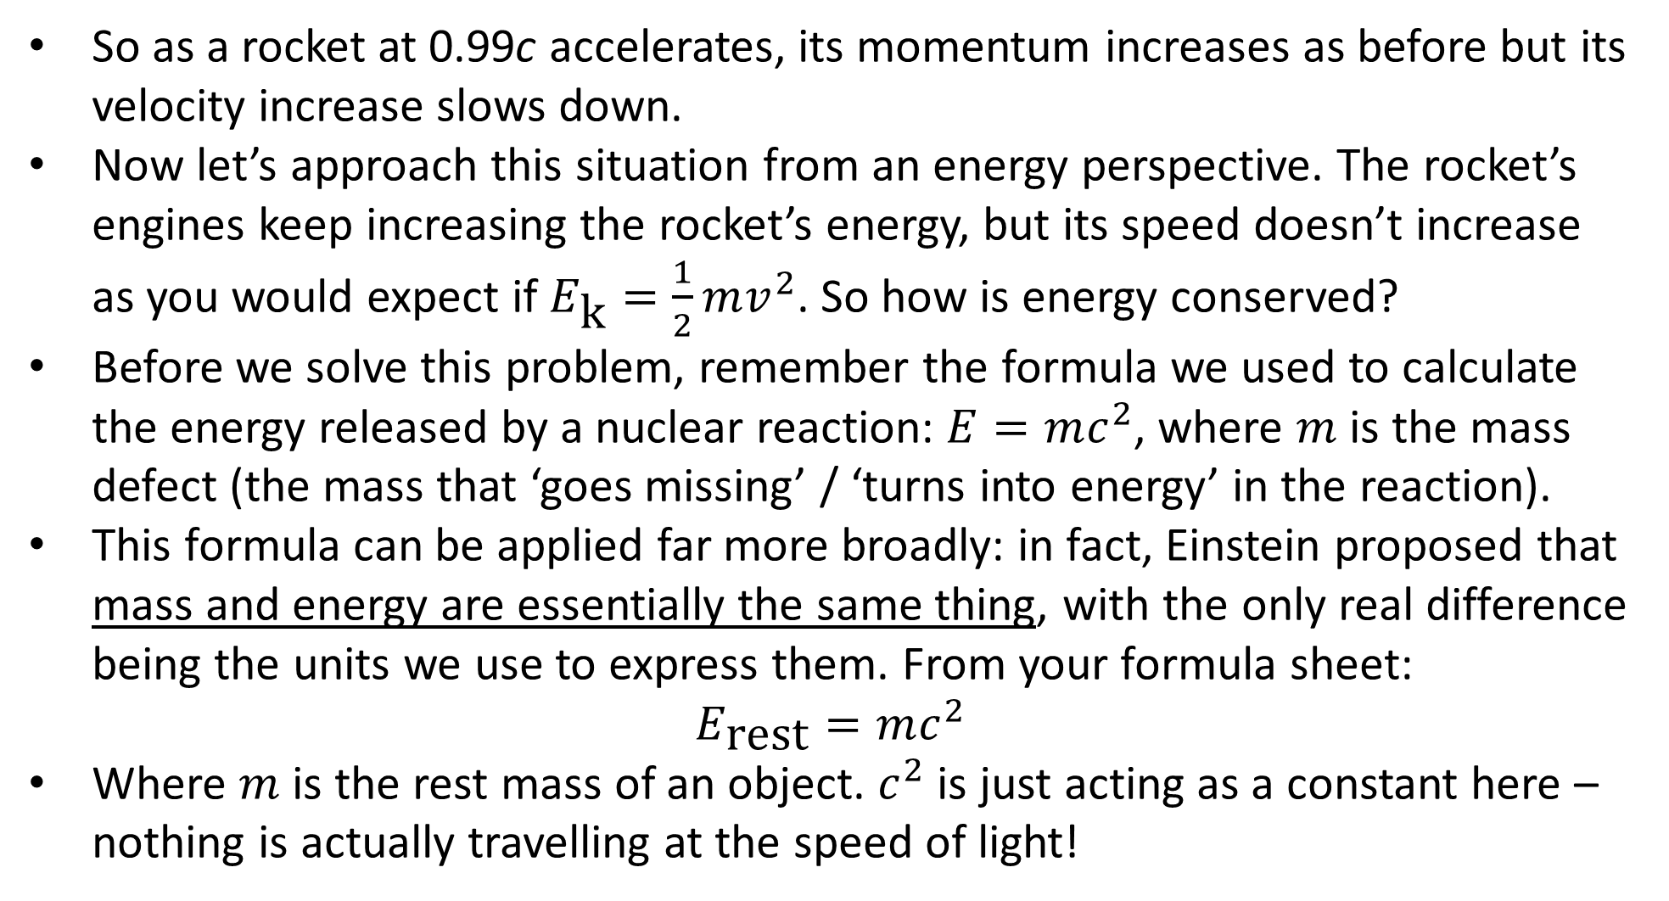
Relativistic Energy
So as a rocket at 0.99c accelerates, its momentum increases as before but its velocity increase slows down.
Now let’s approach this situation from an energy perspective. The rocket’s engines keep increasing the rocket’s energy, but its speed doesn’t increase as you would expect if $E_{\text{k}}=\frac{1}{2}mv^{2}$. So how is energy conserved?
Before we solve this problem, remember the formula we used to calculate the energy released by a nuclear reaction: $E=mc^{2}$, where $m$ is the mass defect (the mass that ‘goes missing’ / ‘turns into energy’ in the reaction).
This formula can be applied far more broadly: in fact, Einstein proposed that mass and energy are essentially the same thing, with the only real difference being the units we use to express them. From your formula sheet:
$$E_{\text{rest}}=mc^{2}$$
Where $m$ is the rest mass of an object. $c^{2}$ is just acting as a constant here – nothing is actually travelling at the speed of light!

Slide 4
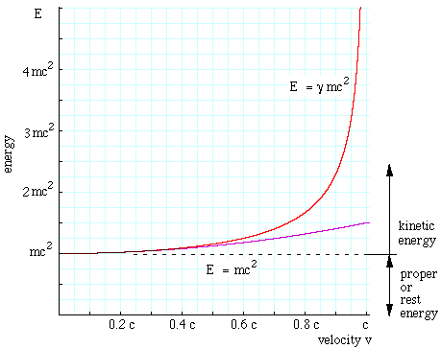
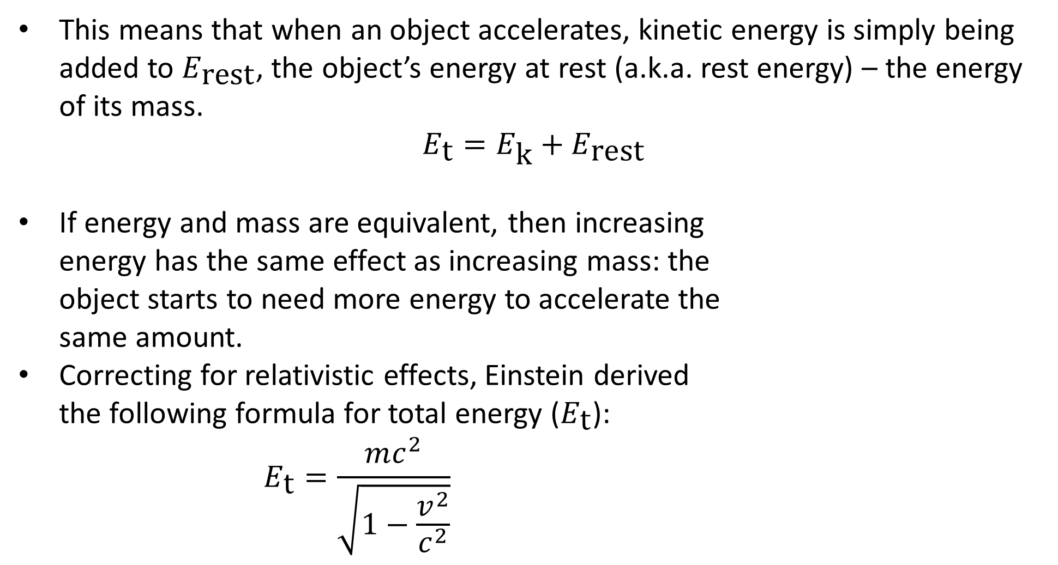
Relativistic Energy
This means that when an object accelerates, kinetic energy is simply being added to $E_{\text{rest}}$, the object’s energy at rest (a.k.a. rest energy) – the energy of its mass.
$$E_{\text{t}}=E_{\text{k}}+E_{\text{rest}}$$
If energy and mass are equivalent, then increasing energy has the same effect as increasing mass: the object starts to need more energy to accelerate the same amount.
Correcting for relativistic effects, Einstein derived the following formula for total energy ($E_{\text{t}}$):
$$E_{\text{t}}=\frac{mc^{2}}{\sqrt{1−\frac{v^{2}}{c^{2}}}}$$
red line: relativistic energy
pink line: classical energy
dotted line: rest energy

Slide 5
Example #1
The average home in Canada uses 3.6 × 10¹⁰ J of energy per day. Imagine that a cabbage with a rest mass of 0.750 kg could be completely converted to another form of energy (note that even in nuclear reactions only a tiny fraction of the mass is converted into electrical energy).
Calculate how much energy would be released by the cabbage.
Determine the number of days this cabbage could supply energy for an average home in Canada.
Notes:
6.75 × 10¹⁶ J
1.88 × 10⁶ days – more than 5000 years!

Slide 6
Example #2
An electron has a speed of 0.900c in a laboratory. With respect to the laboratory’s frame of reference, calculate the electron’s
rest energy,
total energy, and
kinetic energy.
Give your answers in MeV.
Notes:
0.512 MeV
1.18 MeV
0.663 MeV

Slide 7
Example #3
When it comes near a nucleus, a photon’s energy can be converted into an electron and a positron in a process known as pair production. (A positron – also known as an antielectron – has the same mass as an electron but an opposite charge.)
Show that the photon must have at least 1.02 MeV of energy to undergo pair production.
In the rest frame of the electron, the positron produced moves off at 0.75c. What is the frequency of the gamma ray responsible for the pair production as observed in rest frame of the electron?
Notes:
E_{p} = 2 × E_{rest} = 1.02 MeV
E_{p} = E_{rest e-} + E_{rest e+} + E_{k e+} = E_{rest e-} + E_{t e+}. f = 3.11 × 10²⁰ Hz

